Slide 1
What is Sustainable Finance?

Slide 2
What are we going to analyze?
Main skills/competencies targeted: Financing in a sustainable way
How to build a sustainable finance: rules and framework?
Why do banks exist?
Sustainable banking: a stakeholder approach

Slide 3

We start from our own research and results
Turgot PRIZE in 2012

Slide 4
What is « Sustainable Finance»?
Our contribution
New financial research - 16 academics, scolars and Professional experts have converged in « Sustainable finance: a new finance for the 21st century?” (book published in sept. 2011)
Book supported by French Professional Banking Organization – FBF - Directed by Dhafer SAIDANE and Pascal GRANDIN –SKEMA Business School

Slide 5
The 5 RULES/FEATURES OF SUSTAINABLE FINANCE
RESPONSIBLE - for Planet and People. It’s response to the financial crisis.
USEFUL - Understandable by everyone, transparent and must serve growth. It’s linked to the real economy and customers satisfaction (useful and not complex ...)
SAFE - Based on a calculated risk/Return that does not threaten systemic stability.
CLEAN - Based on a good governance respecting gender balance and democracy
ALTRUISTIC – Focus on long term return respecting an inter-generational welfare

Slide 6
THE SUSTAINABLE FINANCE PRINCIPLES
« The Magic Box »
New financial approaches and new individual behaviors and mindset | Financing sustainable & Green growth | Close to people, friendly and performant | No rejection of the conventional finance but less excess
Ethics is a key point. Traditional finance has separated finance and Ethics. It arises from a simplified conception of rationality in finance. | Sustainable Banks fund long-term “Green Business”/Climate change with Customer satisfaction and seeking Stability in the financial system. | This Finance is respectful of human dignity. Microfinance, for example, seeks to manage/reconcile social satisfaction and financial performance. Finance should be transparent and traceable. | Sustainable finance is trying to correct the major failure of conventional finance that is excess of: Return, profit, interest, bonus, consumption, expense...

Slide 7
Conventional Finance vs Sustainable Finance
 | Principle n°1 Ethics | Principle n°2 Sustainable development | Principle n°3 Performance | Principle n°4 Less excess
Conventional Finance | No | No | Yes | No
Sustainable Finance | Yes | Yes | Yes | Yes
The 4 Principles of Sustainable finance

Slide 8

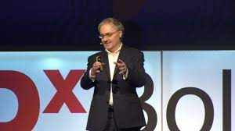
SCHOLAR MINDSET SHIFT
Shiller, R. J. (2013). Finance and the good society.
Princeton: Princeton University Press.
Benedikter, R. (2011). Social banking and social finance.
In R. Benedikter (Ed.), New York: Springer.
Robert James Shiller is
a successful American economist, academic,
and writer. He is a professor of economics at Yale University.
Roland Benedikter is Co-Head of the Center for Advanced Studies, UNESCO
The shift towards sustainable finance is a change of mindset influenced by the crisis.
It’s a new “financial humanism” taking the form of CSR and ESG

Slide 9
Sustainable finance
Set of values that gives priority to
ethics
ecological choices,
social utility,
public interest,
local development,
long-term returns over short-term profit maximization

Slide 10
The role of Banks/financial markets in the traditional economic system
Feelings, Humanity, Nature…are absent…
International
markets
Financial markets and Banks play a “mechanical” role in the economy.
Imports
Exports
Government
Taxes
Investments
Banks/Financial Market
Savings
Investments
Consumption
Households
Companies
Production
National Accounting

Slide 11
The bank is not only a safe-deposit box
We need « sustainable » Bankers more than Banks
SKILLS
Intelligence Central Agency
Balance Sheet
Assets
Liabilities
Loans
Deposits
Risk of Default
Risk of liquidity
Asymetry of information
Asymetry of information
Risk of transformation

Slide 12
Why do banks exist?
The bank is not only a safe-deposit box
The role of banks consists of transforming households surpluses : Deposit into Loans.
Connecting lenders and borrowers.
Banks must screen borrowers and monitor loans.
The raison d’être of banks is due to the existence of frictions in capital markets (Saunders, 2000; Hubbard, 1994; Freixas and Rochet, 1998).
These frictions arise due to insufficient information and knowledge on households and businesses (asymmetry of information).

Slide 13
Bank functions: a sum up
General:
  information services (reducing savers’ monitoring costs);
  liquidity services (increasing savers’ liquidity);
  price-risk reduction services (diversification, brokerage and asset transformation);
  transaction-costs-reducing services (economies of scale through pooling).
Institution-specific:
  money supply;
  credit allocation (between sectors);
  intergenerational transfers;
  payment services

Slide 14
Country | % of total | % of total | % of total | Bank assets, | Equity
 | GDP | bank assets | equity | % of GDP | capitalization,
 |  |  | capitalization |  | % of GDP
Iceland | 0.0 | 0.0 | 0.1 | 62 | 219
Luxembourg | 0.1 | 1.9 | 0.0 | 3461 | 70
New Zealand | 0.2 | 0.2 | 0.1 | 125 | 55
Ireland | 0.4 | 0.5 | 0.2 | 241 | 59
Portugal | 0.5 | 0.7 | 0.2 | 218 | 60
Greece | 0.5 | 0.2 | 0.7 | 66 | 163
Finland | 0.6 | 0.4 | 1.5 | 102 | 367
Norway | 0.7 | 0.4 | 0.2 | 88 | 41
Denmark | 0.8 | 0.6 | 0.3 | 108 | 63
Austria | 0.9 | 1.6 | 0.1 | 234 | 13
Sweden | 1.0 | 0.8 | 1.2 | 109 | 159
Belgium | 1.1 | 2.3 | 0.3 | 294 | 41
Switzerland | 1.1 | 3.5 | 2.2 | 433 | 257
The Netherlands | 1.7 | 3.1 | 2.5 | 267 | 196
Australia | 1.7 | 1.3 | 1.3 | 111 | 106
Spain | 2.5 | 3.0 | 1.2 | 160 | 61
Canada | 2.7 | 2.0 | 2.5 | 114 | 121
Italy | 5.2 | 5.0 | 1.9 | 134 | 51
United Kingdom | 6.1 | 7.9 | 9.4 | 223 | 201
France | 6.3 | 12.2 | 5.0 | 270 | 108
Germany | 9.3 | 13.8 | 4.0 | 205 | 58
Japan | 18.1 | 20.9 | 15.2 | 137 | 108
United States | 38.5 | 17.5 | 49.8 | 70 | 166
Total | 100.0 | 100.0 | 100.0
EU-15 | 36.9 | 54.1 | 28.6 | 201 | 105
EMU-12 | 29.0 | 44.8 | 17.7 | 214 | 81
Financial sector in developed countries
The first three columns show the country’s position in relation to the total of all developed countries in terms of GDP, bank assets and equity capitalization.
The last two columns show the size of the banking and equity markets in each country in relation to their GDPs (Market Based/Bank Based).
The countries are ranked according to their share of total developed countries’ GDP, starting with the country with the smallest GDP.
This allows the three largest economic zones at the end of the table – the US, the EU and Japan – to be compared easily.

Slide 15
Rank | BANK | Total asset | Country
1 | Industrial and Commercial Bank of China Limited | $5.5 trillion | China
2 | China Construction Bank | $4.7 trillion | China
3 | Agricultural Bank of China | $4.5 trillion | China
4 | Bank of China | $4.2 trillion | China
5 | JPMorgan Chase | $3.3 trillion | United States
6 | BNP Paribas | $2.9 trillion | France
7 | China Development Bank | $2.69 trillion | China
8 | Bank of America | $2.5 trillion | United States
9 | Mitsubishi UFJ Financial Group | $2.35 trillion | Japan
10 | Crédit Agricole | $2.34 trillion | France
11 | Sumitomo Mitsui Banking Corporation | $2.06 trillion | Japan
12 | Postal Savings Bank of China | $1.97 trillion | China
13 | Japan Post Bank | $1.97 trillion | Japan
14 | Bank of Communications | $1.91 trillion | China
15 | Banco Santander | $1.8 trillion | Spain
16 | Wells Fargo | $1.8 trillion | United States
17 | Groupe BPCE | $1.7 trillion | France
18 | Mizuho Financial Group | $1.7 trillion | Japan
19 | Citigroup Inc. | $1.66 trillion | United States
20 | Société Générale | $1.66 trillion | France
21 | UBS + Credit Suisse | $1.6 trillion | Switzerland
22 | Deutsche Bank | $1.49 trillion | Germany
23 | China Merchants Bank | $1.45 trillion | China
24 | Barclays | $1.43 trillion | United Kingdom
25 | Toronto-Dominion Bank | $1.40 trillion | Canada
26 | Royal Bank of Canada | $1.37 trillion | Canada
27 | Industrial Bank (China) | $1.35 trillion | China
28 | Shanghai Pudong Development Bank | $1.27 trillion | China
29 | HSBC | $1.26 trillion | United Kingdom
30 | China Citic Bank Corporation Limited CNCB | $1.26 trillion | China
31 | Intesa Sanpaolo | $1.21 trillion | Italy
32 | The Agricultural Development Bank of China | $1.14 trillion | China
33 | China Minsheng Bank | $1.09 trillion | China
34 | ING Group | $1.08 trillion | Netherlands
35 | UniCredit | $1.04 trillion | Italy
36 | Bank of Nova Scotia | $1.04 trillion | Canada
Biggest banks in the world, as measured by total assets, 2023
Threat for the Global stability?
Total Size of Top 36 Banks = $74 trillion (World GDP $100 trillion)

Slide 16
Which Storytelling could we compose starting from those concepts ?
Exercise
« Big is Beautiful »
« Too Big to Fail »
« Lender of Last resort »
« Hostage of Bankers »
« Moral Hazard »

Slide 17
Group Deliberation: The "Red/Blue" Split (30 Minutes)
Divide the room into two halves. Each group must prepare a 10-minute defense of their assigned path:
Group RED (The Realists): Argue for an immediate, unconditional bailout.
  Must use: "Big is Beautiful" (market stability) and "Too Big to Fail" (avoiding total collapse).
Group BLUE (The Reformers): Argue for controlled liquidation and letting the bank fail.
  Must use: "Moral Hazard" (the need to teach the market a lesson) and "Hostage of Bankers" (the need to regain state sovereignty).
The Final Vote & Debrief (10 Minutes)
The Vote: The class votes on which path to take.
The Closing Question: As the "Prime Minister," you force the winning group to answer: "You have saved the system, but how will you answer to the taxpayers in ten years?"

Slide 18
The revoking of the McFadden Act (1927) in the US in the 1980s proved a strong stimulus to the cross-state merger process.
The Glass Steagall Act (1933) also prohibited activities in US like joint ventures between banks and insurers, thus causing institutions to become powerful specialists, particularly in the field of investment banking (about seven of the top ten investment banks in the world are American, though this is also due to the enormous capital markets in the US).
The Gramm Leach Bliley Act of 2000 changed this, and allowed for far-reaching collaboration between banks, insurers and brokerage firms. Since then, a trend towards more universal financial institutions has emerged.
In the US: the effect of regulation

Slide 19
A sustainable bank: new business model
It should
1/ Guarantee a strong ecological transition.
2/ Respect not only its Shareholders but also all the stakeholders.

Slide 20
The stakeholder Theory
The stakeholder theory targets an ethical organizational management
It was developed by Edward Freeman in the book Strategic Management: A Stakeholder Approach (1984).
It's a new governance open vision.

Slide 21
Internal and external bank stakeholders
Competitors
Media
Suppliers
Employees
NGOs
Board of
directors
Shareholders
Customers
BANK
Other financial
institutions
Governments
Society

Slide 22
What is the environmental responsibility of banks?
The pollution caused by companies financed by banks is the responsibility of the banks.
Banking products do not directly pollute. Bank customers must assume full responsibility for the pollution they directly generate.

Slide 23
Defensive bank.
Reluctant to support government measures for sustainable development.
Prioritizes its own financial interests.
Environmental protection increases its costs.
Sustainable development is not profitable.
Offensive/Sustainable banking
Preventive Banking
Defensive Banking
Preventive banking.
Cost savings by taking the environment into account (reduction in paper, energy, and water consumption, business travel).
Limiting costs and losses related to environmental risks.
Offensive/Sustainable banking.
New opportunities such as the development of environmental investment funds (Calvert Social Investment Fund, UBS Eco-Performance-Portfolios),
Financing sustainable energy (Solaris Project, a collaboration between Greenpeace and the Rabobank group)
Aiming for both ethical and profitability goals.

Slide 24
SUSTAINABLE BANK
Sustainable bank refers to financial institution that priorities environmental, social, and governance (ESG) factors in their operations and investments (SRI)

Slide 25
SRI: Socially Responsible Investment
A Sustainable Bank deals with SRI
Socially responsible investment, or SRI, is a strategy that considers not only the financial returns from an investment but also its impact on environmental, ethical, or social change (ESG).
SRI is an investment made in sustainable sectors or companies

Slide 26
Active investing involves a fund manager choosing investments, whereas passive investing tracks an existing group of investments called an index.
Passive investing strategies often perform better than active strategies and cost less.
Negative screening : investing in companies that score poorly on environmental, social and governance (ESG) factors relative to their peers.
Active Strategy
Passive Strategy
Shareholder engagement/ Shareholder Activism
Negative Screening
SRI Universe
Positive Screening
Thematic Funds
Best in Class
Positive screening : investing in companies that score highly on environmental, social and governance (ESG) factors relative to their peers.
The best-in-class : investing in companies that are leaders in environmental, social and governance (ESG) criteria.
Thematic funds are investment funds that are focused on specific themes or trends, such as clean energy or technology.

Slide 27
Sustainable banking is a business model
Oriented towards stakeholders + green and social credits.
Accepts “acceptable margins” .
Examples:
Triodos Bank in the Netherlands,
The Co-operative Bank in the United Kingdom,
La Banque Postale in France...

Slide 28
How to define sustainable bank?
Customer/ ecological environment satisfaction,
No excessive profitability
Contribution to the stability of the financial system.
The Sustainable Bank = strong financial business + performance + responsibility towards society + long-term financing.
It is the antidote to the systemic financial crisis.

Slide 29
Sustainable bank
Alternative,
Ethical
Green
ValueS-based (Finance/Human/Nature)
Contribute to the development of people and the planet today and in the future

Slide 30
How to develop a comprehensive strategy for sustainable factors in a bank?
The right method for building a sustainable bank
Bank (1)
Assets | Liabilities
Loans (2) (3) (4) Green Bonds (Issued) | Debt (deposits, bonds…) (5) Equity (6) Green Bonds (Susbscribed)
P&L Profit and loss statement (7)
Consideration of sustainability in the banking business strategy and the organizational system/governance
Identification/classification of sustainable assets
Reporting of ESG risks and their impact
Consideration of ESG (risk) in pricing & risk management
Refinancing with sustainable instruments
Consideration of ESG risks within the capital
ESG & extra-financial Data Management

Slide 31
Micro-credit or micro-financing are examples of sustainable banking
Banks via Micro-credit can in developing countries make a contribution to sustainable development by financing and facilitating sustainable energy.

Slide 32
Under the EU Sustainability Reporting Directive (CSRD), companies are required to perform a double materiality assessment
Impact materiality
It assesses how a company's activities affect People and Planet and various stakeholders (including Nature).
Financial materiality
It focuses on factors that directly influence a company's financial performance. This includes the impact on financial indicators, such as cash flow, revenue growth, and profitability.
A big difference between USA and the EU
Double materiality is a European concept, supported by EFRAG (European Financial Reporting Advisory Group) which published the ESRS standards (European Sustainability Reporting Standards) .
In the United States, the ISSB (International Sustainability Standards Board) advocates financial materiality only.

Slide 33
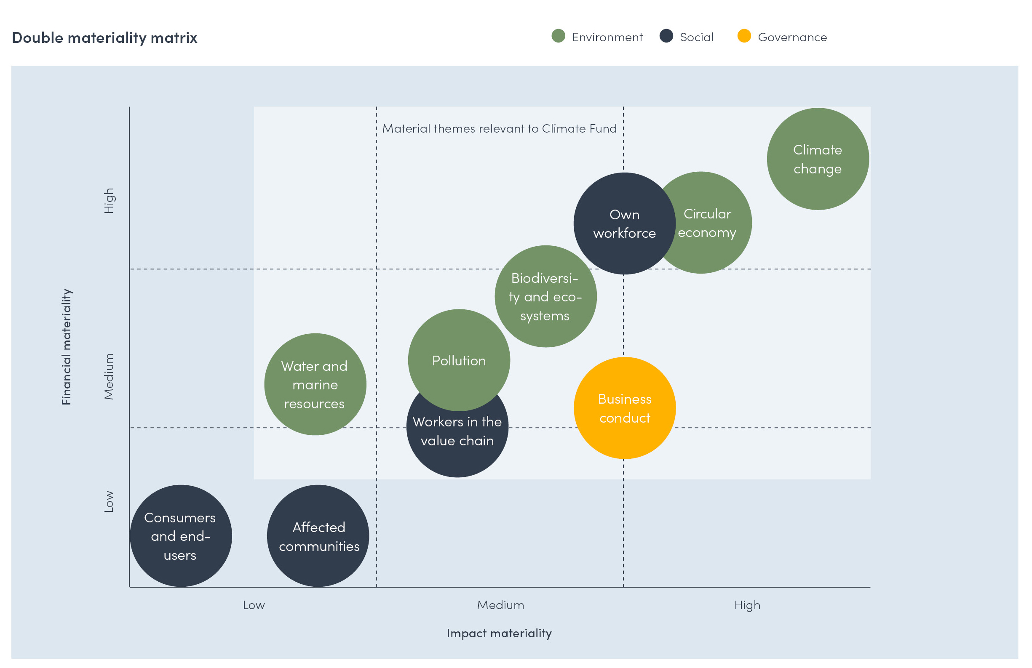

Slide 34
What did we learn from the lesson?
Identify and restore the points retained from the course.
How to build a sustainable finance and sustainable bank: rules and framework
Why do banks exist?
Sustainable banking: a stakeholder approach

Slide 35
WOOCLAP-Sustainable Finance
https://app.wooclap.com/events/OZPZGU/0

